Slide 1

A Review of the Targeting System in Georgia: Proposed Reform Options
South Caucasus Social Protection and Jobs
The World Bank
September 3rd, 2020
Official use only.

Slide 2

Overview
Objectives of the work
Results
Recommendations

Slide 3
Objectives of the work
The Georgian TSA is a high performer relative to other countries adopting comparable targeting.
However, targeting performance has slightly deteriorated in recent years.
Need to preserve the quality of targeting by updating the PMT formula with the changing economy and living conditions since 2013.

Slide 4
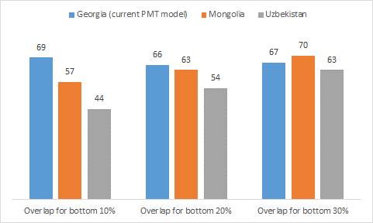
Relatively high performance of TSA targeting.
Percentage of population overlap between ‘true’ and estimated welfare within the bottom 10 percent, 20 percent, and 30 percent of population.
Sources: Authors’ analysis of the 2018 HIES, Uzbekistan Listen to Citizens of Uzbekistan (L2CU) 2018, and 2014 HIES in Mongolia.

Slide 5
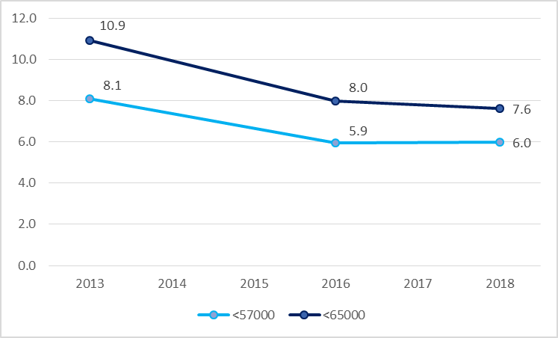
Decrease in coverage over time.
Percentage of households with score below 57,000 and 65,000, 2013–2018
Sources: Estimates for 2013 are based on the third quarter of the Integrated Household Survey and information from an additional ad hoc module (Baum, Mshvidobadze, and Posadas 2016, 13). Estimates for 2016 and 2018 are based on HIES.

Slide 6
Scope of the work
Refining technical features of the current formula;
Testing alternative models to predict household welfare based on most recent (HIES2018) data;
Selecting the best predictive model;
Simulating the new PMT formula on HIES 2018 households and measuring its ability to identify poorest households;
Identifying winners and losers from the new PMT formula;
Note: we are not revising subsistence minimum. That revision is recommended for separate work.

Slide 7
Results
The proposed new formula;
Summary of main changes;
Performance improvements under the new formula.

Slide 8

The proposed new formula
$$PMT score=\frac{e^{\left(Xβ+\frac{σ^{2}}{2}\right)}+ utilities expenditure − TSA allowance}{Household needs}$$
X is a set of explanatory variables;
$β$, $σ^{2}$ are coefficients and variance of the error term;
They vary by type of settlement: Tbilisi, large urban, urban, rural;
Utilities expenditure is measured in 2018 prices;
TSA allowance is fixed at its 2018 value;
Household needs index (not revised here) has subsistence minimum in 2018 prices.

Slide 9
Feature 1: Monetary variables
Monetary variables (utility prices, income, social assistance transfers) that enter PMT formula should be deflated to their 2018 level:
Utility expenditure computed using baseline year prices;
Revenues deflated using CPI;
Social assistance transfers should be fixed at their level in 2018, regardless of policy changes;
Subsistence minimum should be held constant at its value in 2018 prices and not updated.
Reason: the index predicts consumption in 2018 prices, under 2018 policies, based on 2018 explanatory variables (e.g. revenues).

Slide 10
Feature 2: Changing the set of explanatory variables
Separating out revenues by different sources;
Adding employment-related variables;
Accounting for dwelling’s access to basic facilities (e.g. hot water);
Accounting for other movable assets (fridge, washing machine);
Creating a single livestock index based on international practices;
Fine-tuning coefficients for household size and education.

Slide 11
Feature 2: Changing the set of explanatory variables
Removing variables with low explanatory power or easily manipulated (e.g. poultry, beehives, gender of household head);
Other changes were tested and rejected as not improving performance (e.g. type of cultures, interactions between assets and age of household members)

Slide 12
Feature 3: Separately accounting for utility expenditure
Since utility expenditure is directly observable, the formula is not supposed to predict it but, rather, measure it and take it into account.
This improves the formula’s precision in identifying the poorest households, without making any losers.

Slide 13
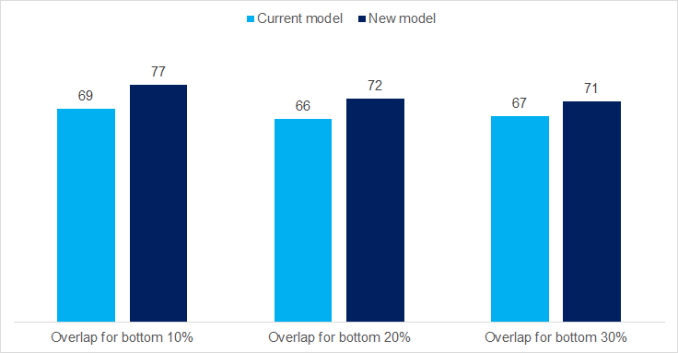
Targeting of the poor improves.
Percentage of population overlap between ‘true’ and estimated welfare within the bottom 10 percent, 20 percent, and 30 percent of population.
Source: Authors’ calculations on HIES 2018.

Slide 14
Targeting improves across settlement types.
Percentage of population overlap between ‘true’ and estimated (PMT) welfare within the poorest 20% of population.
Share of each sub-group in the poorest 20% in brackets.
Source: Authors’ calculations on HIES 2018.

Slide 15
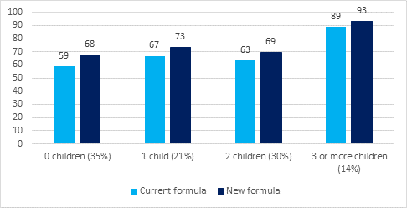
Targeting improves across households types.
Percentage of population overlap between ‘true’ and estimated (PMT) welfare within the poorest 20% of population.
Share of each sub-group in the poorest 20% in brackets.
Source: Authors’ calculations on HIES 2018.

Slide 16
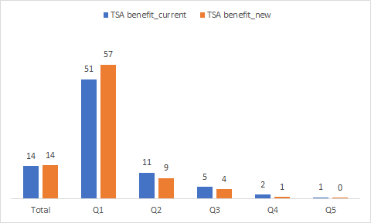
Poorest quintile gets better coverage.
Percentage share of population covered under the current and the new PMT formula, by welfare quintile.
The new PMT formula is assumed to cover the same share of population as the current one.
Source: Authors’ calculations on HIES 2018.

Slide 17
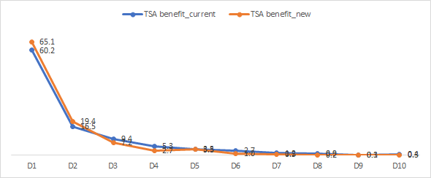
Beneficiaries under the new formula are poorer.
Share of beneficiaries in each decile under the current and the new PMT formula.
The new PMT formula is assumed to cover the same share of population as the current one.
Source: Authors’ calculations on HIES 2018.

Slide 18
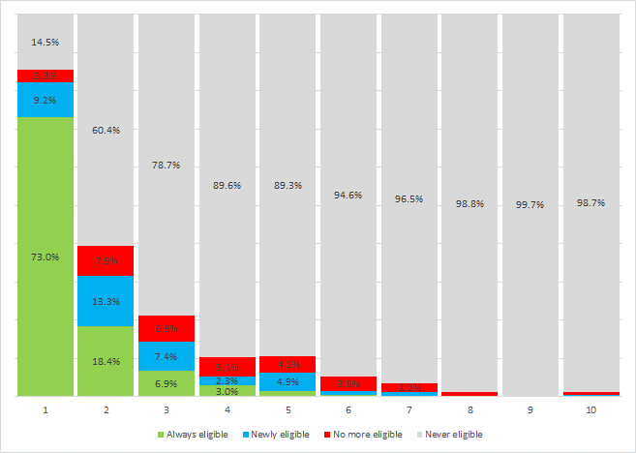
Winners from the transition outnumber losers at lowest deciles.
In each welfare decile, share of population who keeps (green), gains (blue), loses (red) eligibility after the passage to the new formula.
Source: Authors’ calculations on HIES 2018.

Slide 19
The administrative burden decreases.
New information required | Information no longer required
Young cattle (n) | Beehives (n)
Sheep (n) | Poultry (n)
Horses (n) | Soviet manufacturing of owned cars, passenger vehicles, or trucks (yes/no)
Goats (n) | Tractors (except for mini tractors), combines, and seeding machines (n)
Pigs (n) | Revenues from social package and pensions (GEL)
Members with employer provided insurance (n) | At least one member is a child who is of full age and lives as an independent family (yes/no)
Members abroad (n) | Household head is a man (yes/no)
Members who have worked in the past three months (n) | At least one member is less than 16 years old (yes/no)
Refrigerators (yes/no) | Garage (yes/no)
Washing machines (yes/no) | Cellar (yes/no)
Satellite receivers (yes/no) | Kitchen (yes/no)
Access to individual system of hot water (yes/no) | Unfinished house or structure/workshop (yes/no)
Access to individual heating system (yes/no) | Cattle shed (yes/no)
 | Storage hut (yes/no)
 | Basement (yes/no)
 | Commercial area (yes/no)
 | Total area of other owned accommodation (apartment/house) in m²
 | Total area of other country houses owned by the household in m²
 | Mountain location

Slide 20
Recommendations
Immediate term: Adjust monetary variables to their value in the baseline year (2013 for the current formula).
Short term:
Test proposed new formula in small scale and validate it using administrative data sources;
Revise households’ needs index.
Long term: Explore the possibility of moving towards a hybrid system.

